Slide 1
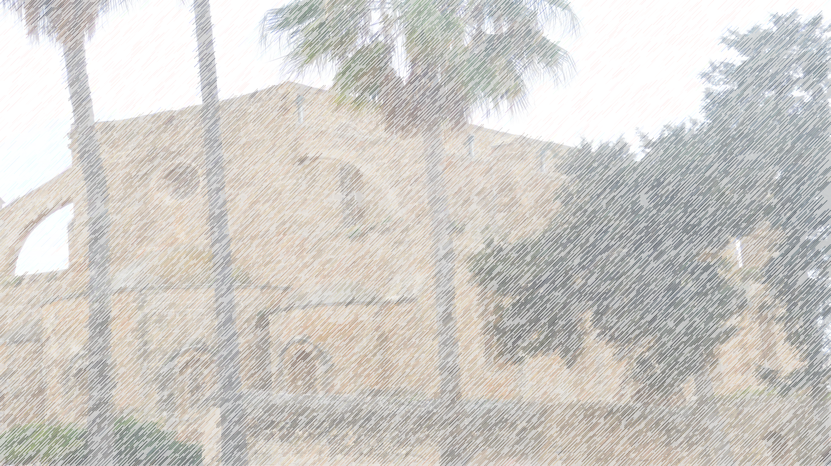
Spring cleaning
John 2:12-25

Slide 2
Spring cleaning
John 2:12-25
Verse 12 = Transition

Slide 3
Spring cleaning
John 2:12-25
1. Out of character?

Slide 4
Spring cleaning
John 2:12-25
Out of character?
As Lord of the Temple, Jesus had authority

Slide 5
Spring cleaning
John 2:12-25
Out of character?
As Lord of the Temple, Jesus had authority
As Lord of the Temple, he described it as ‘unfit for purpose’

Slide 6
Spring cleaning
John 2:12-25
Out of character?
As Lord of the Temple, Jesus had authority
As Lord of the Temple, he described it as ‘unfit for purpose’
Market place

Slide 7
Spring cleaning
John 2:12-25
Out of character?
As Lord of the Temple, Jesus had authority
As Lord of the Temple, he described it as ‘unfit for purpose’
Market place
No self-examination

Slide 8
Spring cleaning
John 2:12-25
Out of character?
As Lord of the Temple, Jesus had authority
As Lord of the Temple, he described it as ‘unfit for purpose’
Market place
No self-examination
No attempt to serve an ASBO

Slide 9
Spring cleaning
John 2:12-25
Out of character?
As Lord of the Temple, Jesus had authority
As Lord of the Temple, he described it as ‘unfit for purpose’
Market place
No self-examination
No attempt to serve an ASBO
4. As Lord of the Temple, authority to cleanse

Slide 10
Spring cleaning
John 2:12-25
Out of character?
As Lord of the Temple, Jesus had authority
As Lord of the Temple, he described it as ‘unfit for purpose’
Market place
No self-examination
No attempt to serve as ASBO
4. As Lord of the Temple, authority to cleanse
5. As Lord of the Temple, the sign given is its destruction!

Slide 11
Spring cleaning
John 2:12-25
Out of character?
As Lord of the Temple, Jesus had authority
As Lord of the Temple, he described it as ‘unfit for purpose’
Market place
No self-examination
No attempt to serve as ASBO
4. As Lord of the Temple, authority to cleanse
5. As Lord of the Temple, the sign given is its destruction!
Misunderstood

Slide 12
Spring cleaning
John 2:12-25
Out of character?
As Lord of the Temple, Jesus had authority
As Lord of the Temple, he described it as ‘unfit for purpose’
Market place
No self-examination
No attempt to serve as ASBO
4. As Lord of the Temple, authority to cleanse
5. As Lord of the Temple, the sign given is its destruction!
Misunderstood
Real significance

Slide 13
Spring cleaning
John 2:12-25
Out of character?
As Lord of the Temple, Jesus had authority
As Lord of the Temple, he described it as ‘unfit for purpose’
Market place
No self-examination
No attempt to serve as ASBO
4. As Lord of the Temple, authority to cleanse
5. As Lord of the Temple, the sign given is its destruction!
6. Superficial faith based on signs

Slide 14
Spring cleaning
John 2:12-25
Out of character?
As Lord of the Temple, Jesus had authority
3. As Lord of the Temple, he described it as ‘unfit for purpose’
i. Market place
a. No self-examination
b. No attempt to serve as ASBO
4. As Lord of the Temple, authority to cleanse
5. As Lord of the Temple, the sign given is its destruction!
6. Superficial faith based on signs
Lessons:-

Slide 15
Spring cleaning
John 2:12-25
Out of character?
As Lord of the Temple, Jesus had authority
As Lord of the Temple, he described it as ‘unfit for purpose’
Market place
No self-examination
No attempt to serve as ASBO
4. As Lord of the Temple, authority to cleanse
5. As Lord of the Temple, the sign given is its destruction!
6. Superficial faith based on signs
Lessons:- What message for us?

Slide 16
Spring cleaning
John 2:12-25
Out of character?
As Lord of the Temple, Jesus had authority
As Lord of the Temple, he described it as ‘unfit for purpose’
Market place
No self-examination
No attempt to serve as ASBO
4. As Lord of the Temple, authority to cleanse
5. As Lord of the Temple, the sign given is its destruction!
6. Superficial faith based on signs
Lessons:- What message for us? Objectives?

Slide 17
Spring cleaning
John 2:12-25
Out of character?
As Lord of the Temple, Jesus had authority
As Lord of the Temple, he described it as ‘unfit for purpose’
Market place
No self-examination
No attempt to serve as ASBO
4. As Lord of the Temple, authority to cleanse
5. As Lord of the Temple, the sign given is its destruction!
6. Superficial faith based on signs
Lessons:- What message for us? Objectives?
What cleaning needed here?

Slide 18
Spring cleaning
John 2:12-25
Out of character?
As Lord of the Temple, Jesus had authority
As Lord of the Temple, he described it as ‘unfit for purpose’
Market place
No self-examination
No attempt to serve as ASBO
4. As Lord of the Temple, authority to cleanse
5. As Lord of the Temple, the sign given is its destruction!
6. Superficial faith based on signs
Lessons:- What message for us? Objectives?
What cleaning needed ? Individual (1 Cor.6:19-20)

Slide 19
Spring cleaning
John 2:12-25
Out of character?
As Lord of the Temple, Jesus had authority
As Lord of the Temple, he described it as ‘unfit for purpose’
Market place
No self-examination
No attempt to serve as ASBO
4. As Lord of Temple, authority to cleanse
5. As Lord of Temple, the sign given is its destruction!
6. Superficial faith based on signs
Lessons:- What message for us? Objectives?
What cleaning needed? Individual (1 Cor.6:19-20)
Ears to hear

Slide 20
Spring cleaning
John 2:12-25
Out of character?
As Lord of the Temple, Jesus had authority
As Lord of the Temple, he described it as ‘unfit for purpose’
Market place
No self-examination
No attempt to serve as ASBO
4. As Lord of the Temple, authority to cleanse
5. As Lord of the Temple, the sign given is its destruction!
6. Superficial faith based on signs
Lessons:- What message for us? Objectives?
What cleaning needed? Individual (1 Cor.6:19-20)
Ears to hear – strategic outreach

